Slide 1
Feedback on CONDUCTIX (Jay Electronique) radio tests
18/10/2023
Carried out on 17/10/2023
Location: Training Center (Sens)
Operators: Matthieu Delefortrie
Brice Belin

Slide 2
Agenda
Conductix radio presentation
Tests functionalities
Remarks
Conclusions

Slide 3
CONDUCTIX radio presentation
01
Comparison with old CAVOTEC
(not actual Face T)

Slide 4
Front side
01

Slide 5
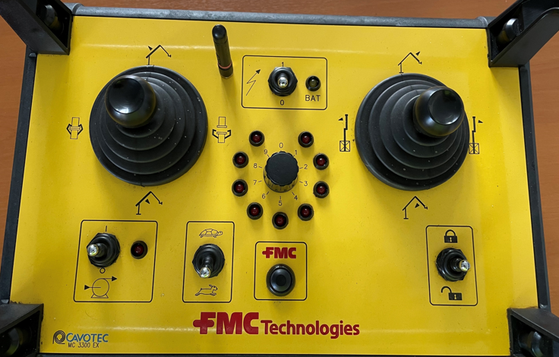
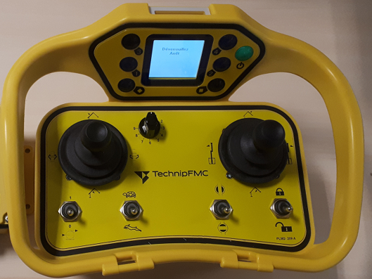
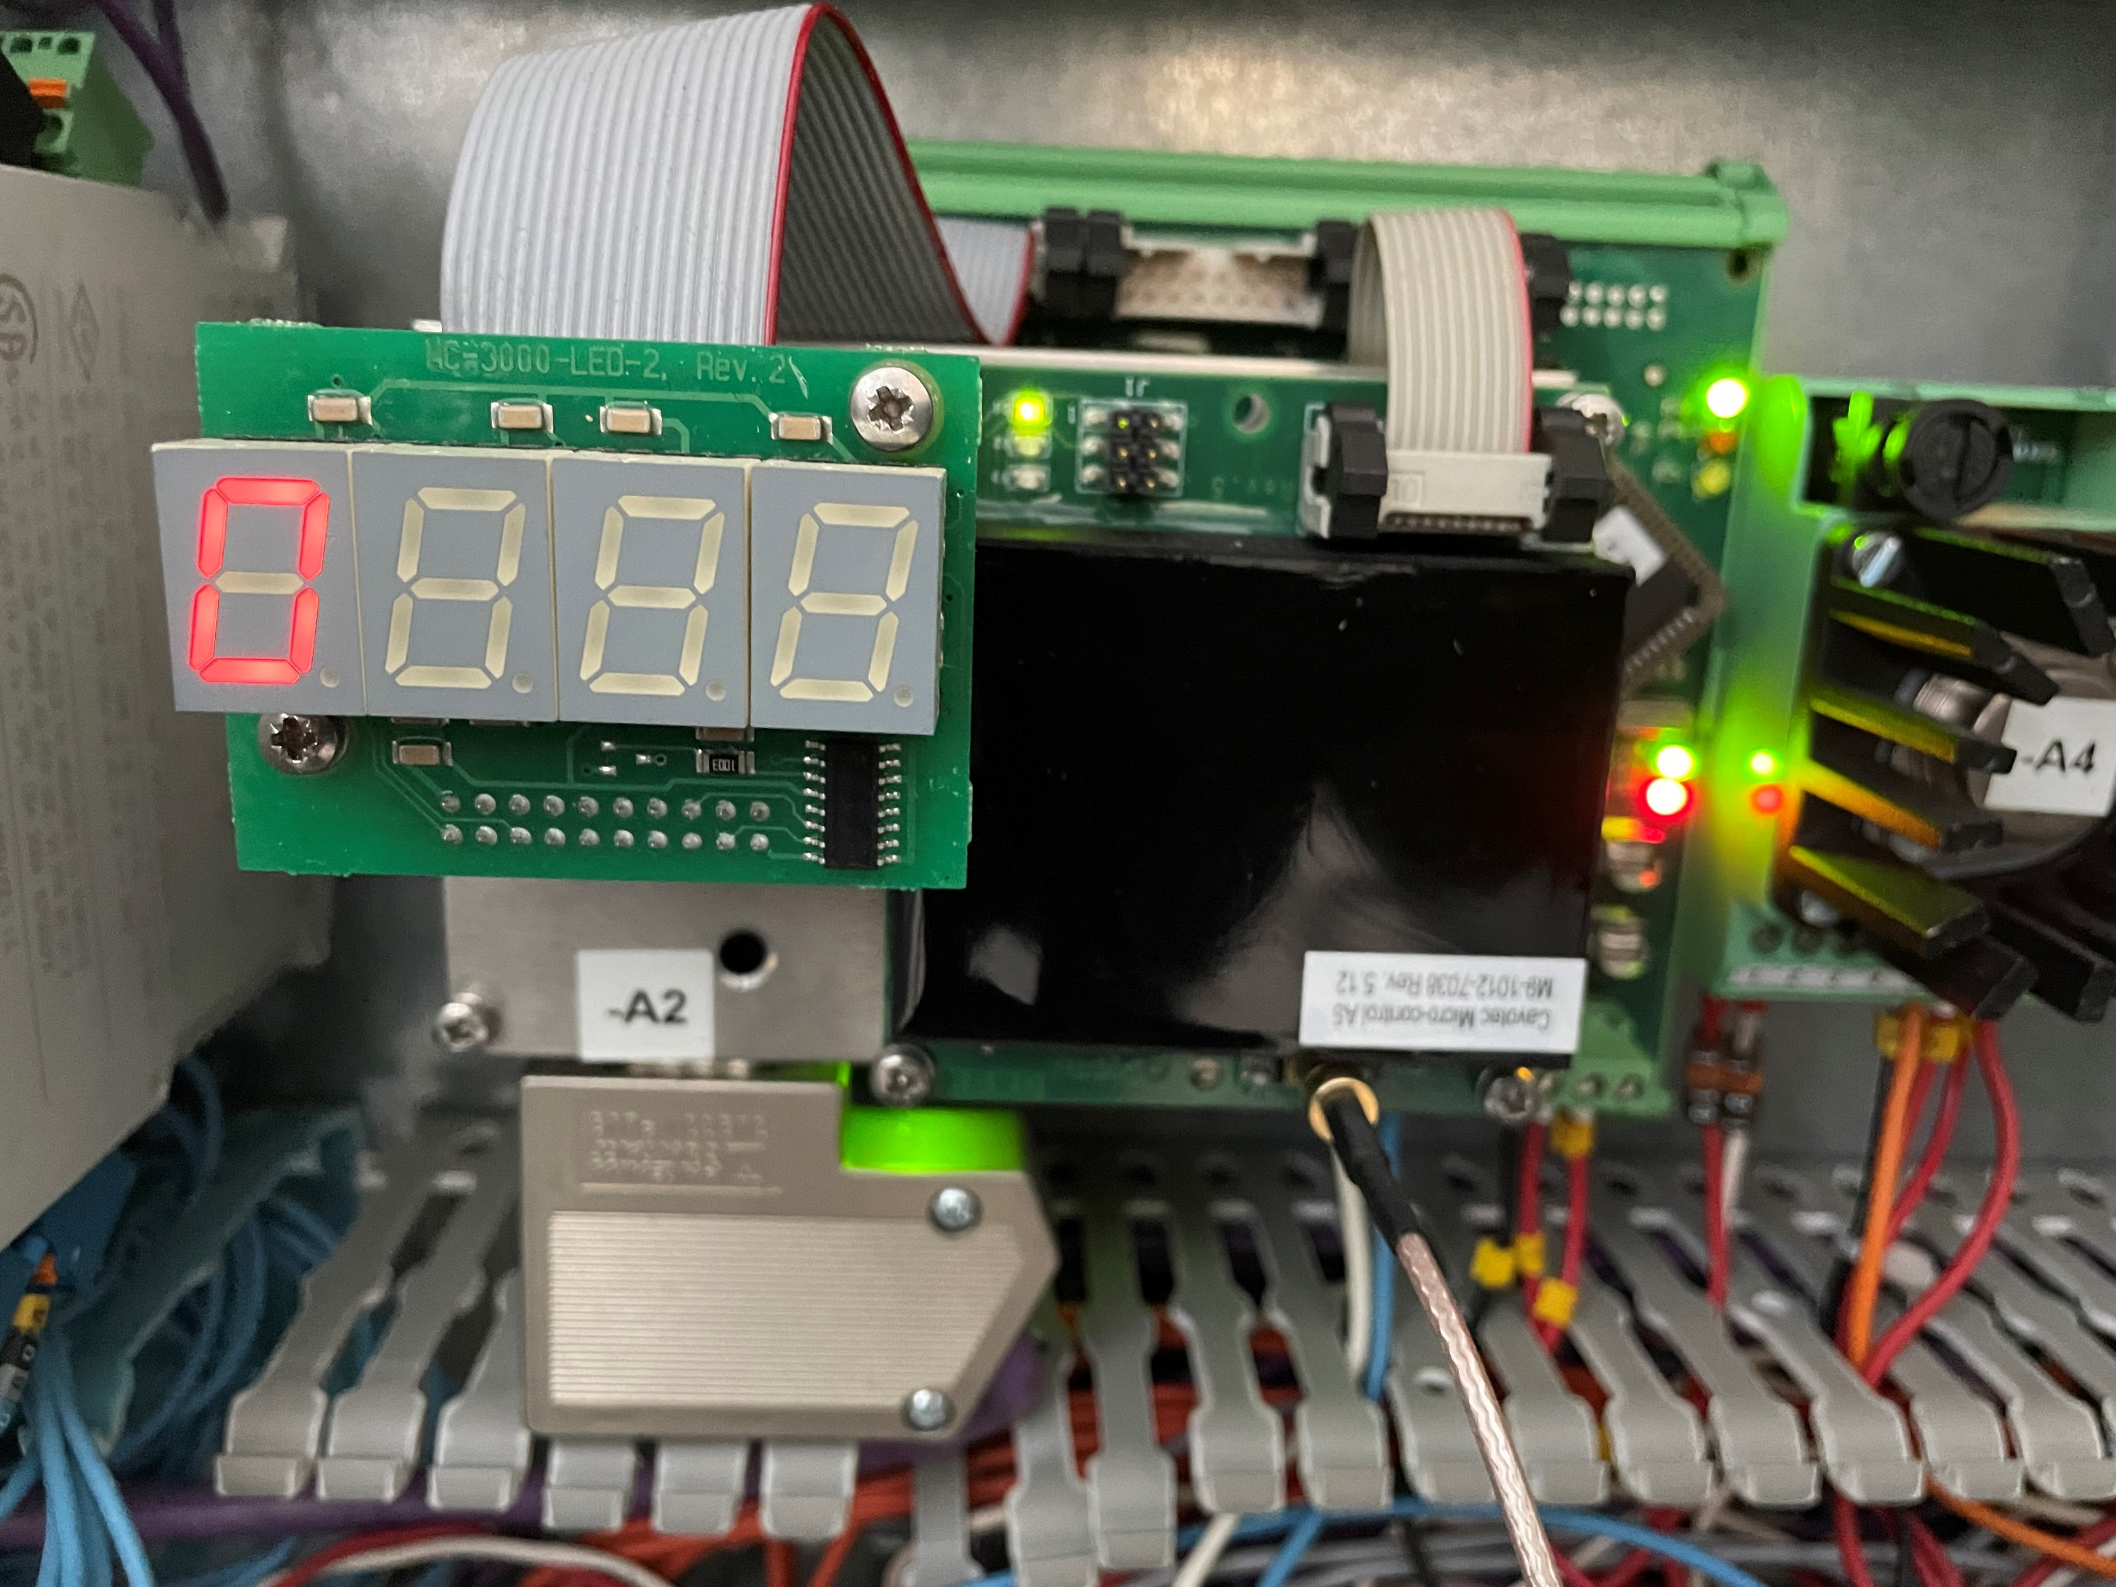
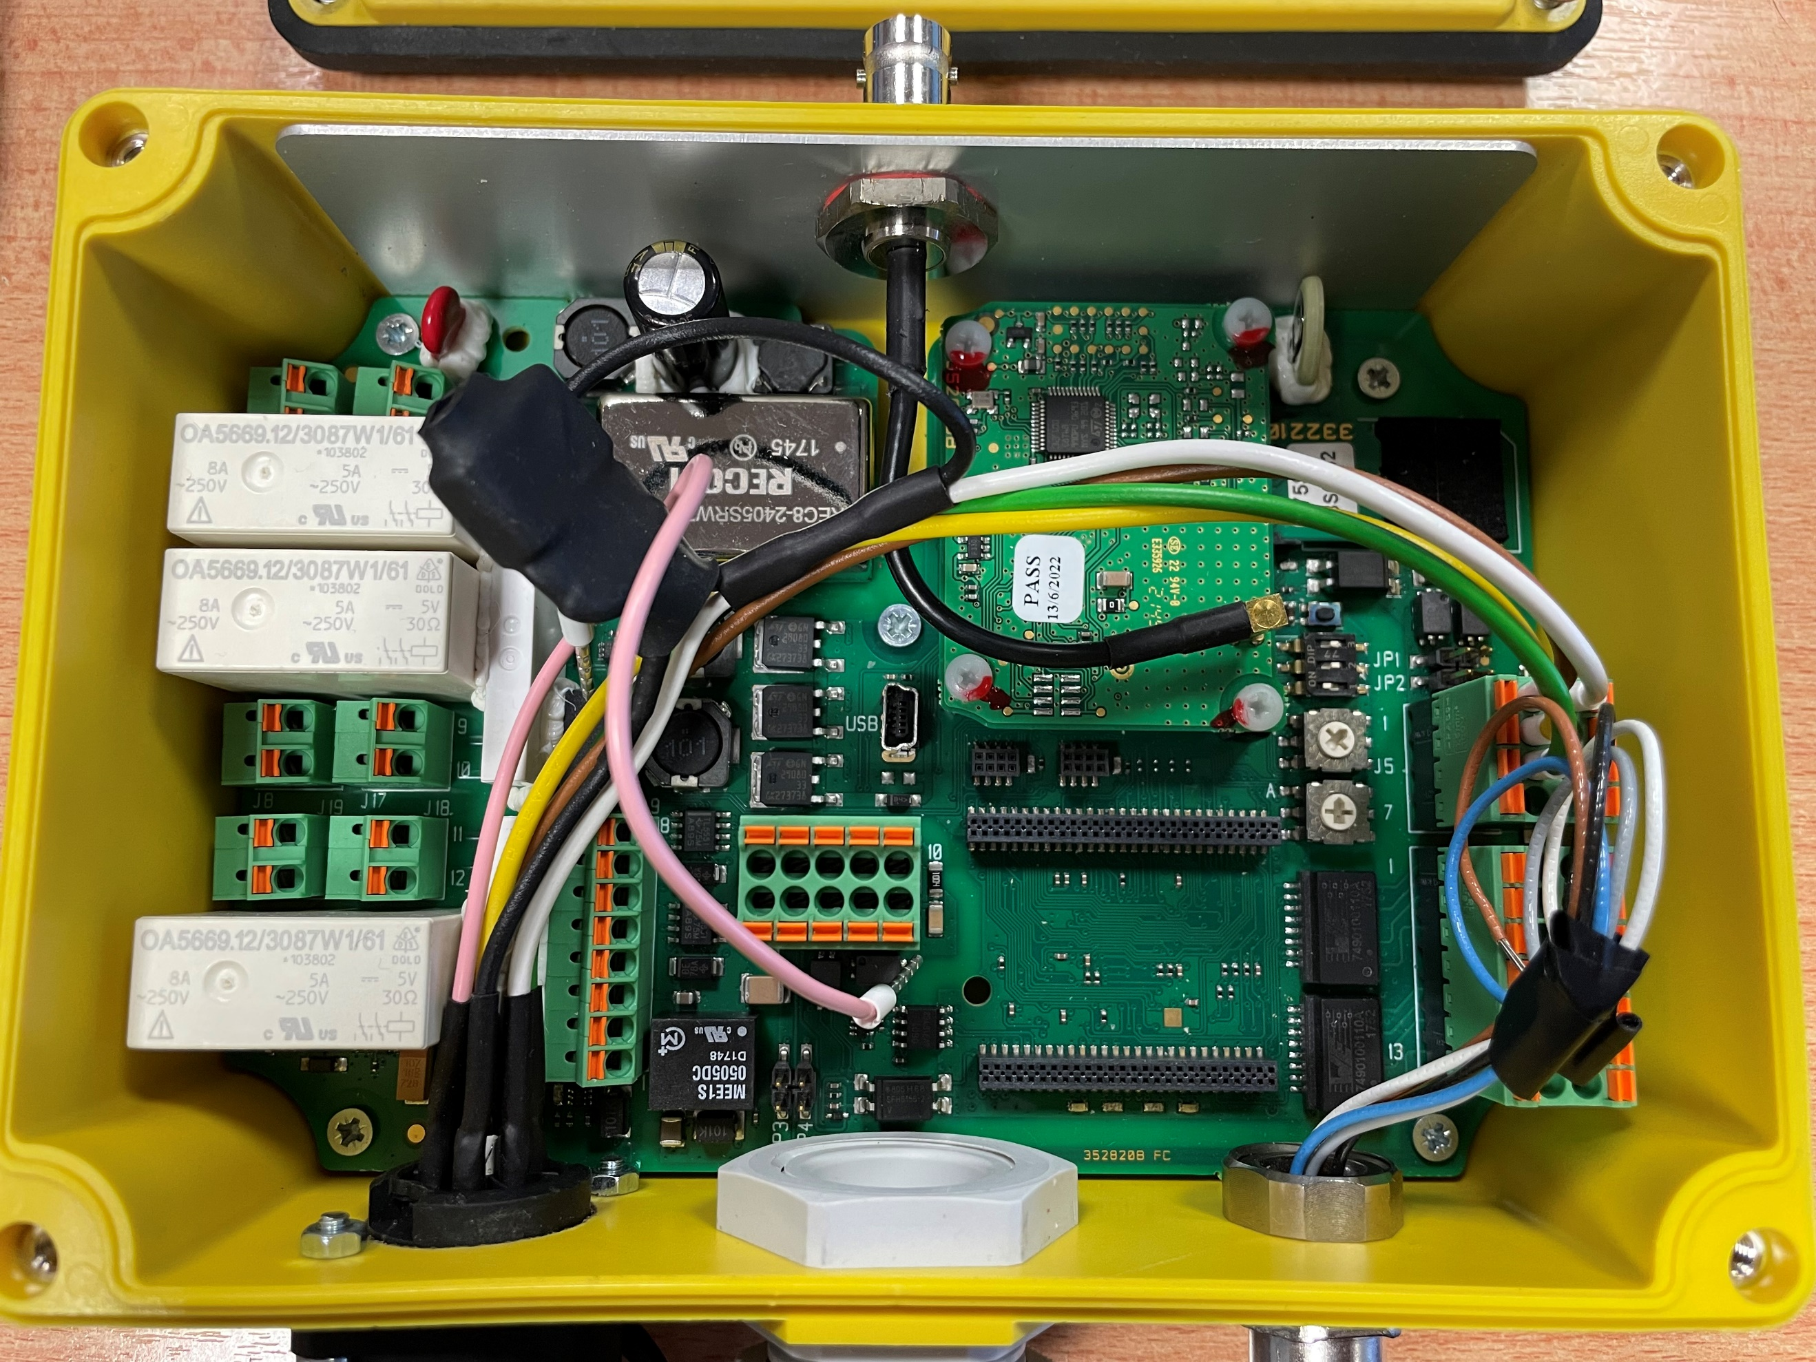
Comparison with CAVOTEC
Actual - CAVOTEC | Tested - CONDUCTIX | Remarks
Transmitter: MC 3300 EX | Transmitter: MOKA
 |  | Communication: PROFIBUS DP
Receiver: xxxx: | Receiver: NEMO
Logo is not the last
No lights for arms
selections
Small displayed
Nota:
Do same tests with Profinet communication (or simulation)

Slide 6
Tests functionalities
02
Comparison with old CAVOTEC
(not actual Face T)

Slide 7
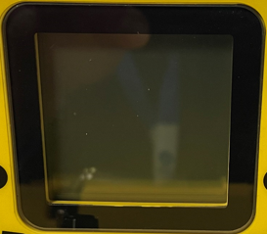
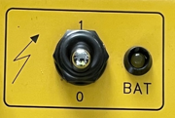
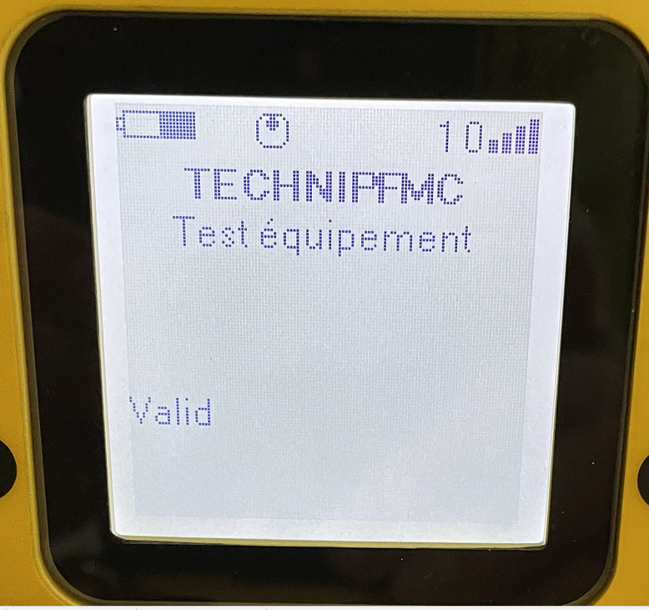

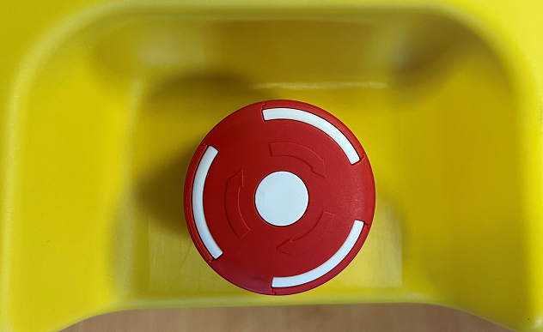
Comparison with CAVOTEC
2.1/ Switch ON / OFF radio
Actual - CAVOTEC | Tested - CONDUCTIX | Remarks
Switch with 2 positions LED status: On = radio ON OFF = radio OFF | Button must be pressed
 |  | Actually we use this emergency button to STOP PUMP on Cavotec radio
 | Switch off with Emergency Stop button
Standbye time: 10 min | X
Switched off time: 15 min | Switched off time: 4 min
Logo is not the last
No lights for arms
selections
Small displayed

Slide 8
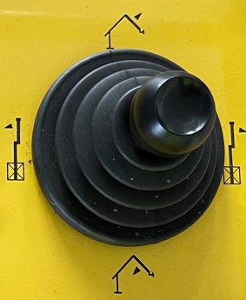
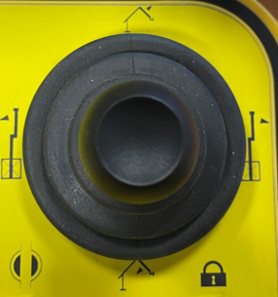
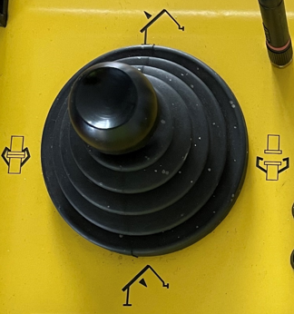
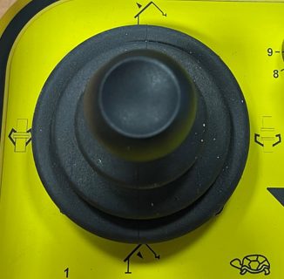
Comparison with CAVOTEC
2.2/ Arm movements
Actual - CAVOTEC | Tested - CONDUCTIX | Remarks
Left
Right
Slewing movements
=> validated
Outboard movements
=> validated
Back
Back
Inboard movements
=> validated
Forward
Forward
close
open
close
open
Coupler movements
=> Not validated
Not works on our loan material

Slide 9


Comparison with CAVOTEC
2.2/ Arm movements
Actual - CAVOTEC | Tested - CONDUCTIX | Remarks
No DBV commands on radio Only on LCP
Back
DBV movements
=> validated

Slide 10
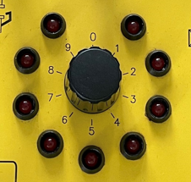
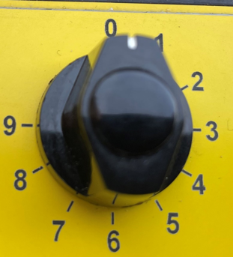
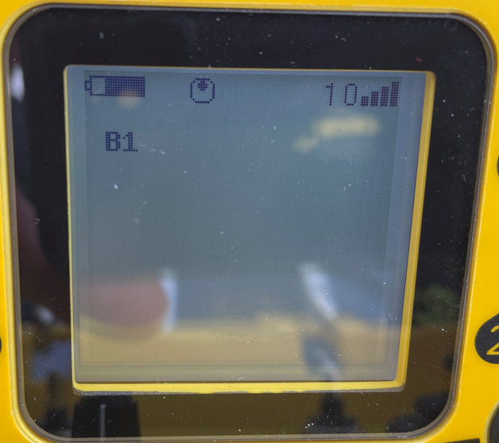
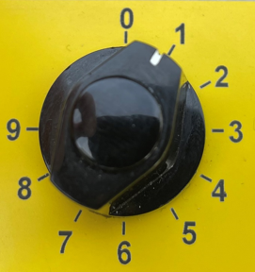
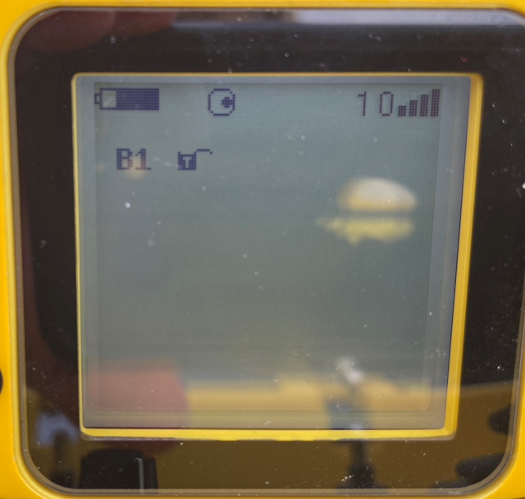

Comparison with CAVOTEC
2.3/ Arm status on radio
Actual - CAVOTEC | Tested - CONDUCTIX | Remarks
Switch multi-positions Led status OFF = Not selected blinking = selected ON = Locked …. ….
No lights for arms
selections
Picture displayed
B1 = Arm 1
Icone displayed
B1 displayed
Lock open = selected arm
Icone displayed
B1 displayed
Lock close = Locked arm

Slide 11
Remarks
03

Slide 12
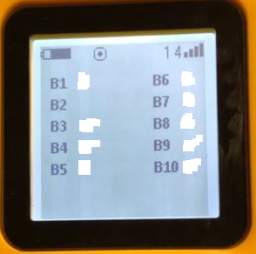

Remarks after tests
Points to be discuss:
Confirmed or not to have 3 status per arms
Suggestion: maybe 2 pictures are enough
Delecte picture nr1
Pictures are displayed in front of the main screen
Suggestion: See if it’s possible to call other pages with same picture as upper
[1] Arm not selected | [2] Arm selected | [3] Arm Locked
[1] Main Screen | [2] Pictures called

Slide 13
Remarks after tests
Points to be discuss:
Emergency Stop button use to switch off radio
Discuss with Conductix if possible, to use another button
Suggestion:
Press 1s on green button to switch ON
Press more than 2s on green button to switch OFF
Possible to add new texts or new pictures
Suggestion
Pump running
Pump Stop
Possible to connect cable on CONDUCTIX radio
Like pendant mode on CAVOTEC radio
[1] Arm not selected | [2] Radio ON | [3] Radio OFF
Pressed Pressed

Slide 14
Conclusion
04

Slide 15
General conclusion
CONDUCTIX remote vs CAVOTEC remote
CONDUCTIX remote do the same work like CAVOTEC remote
Some points need to be discussed and improved
Add new message
change or improve the arm status displayed
Some points need to be solved
Lost information “Présence radio réception” send by Moka radio during manipulation
How to change standby value on radio Moka
Another day of testing will be scheduled with its improvements
days should be defined with Training Center availibility

